Slide 1


Breed Multiplication Farm (BMF)

Slide 2

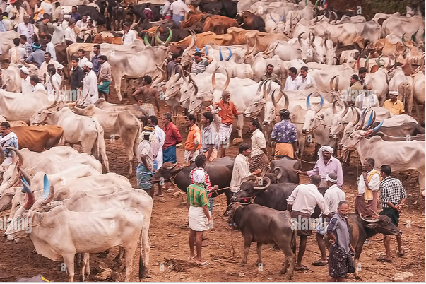
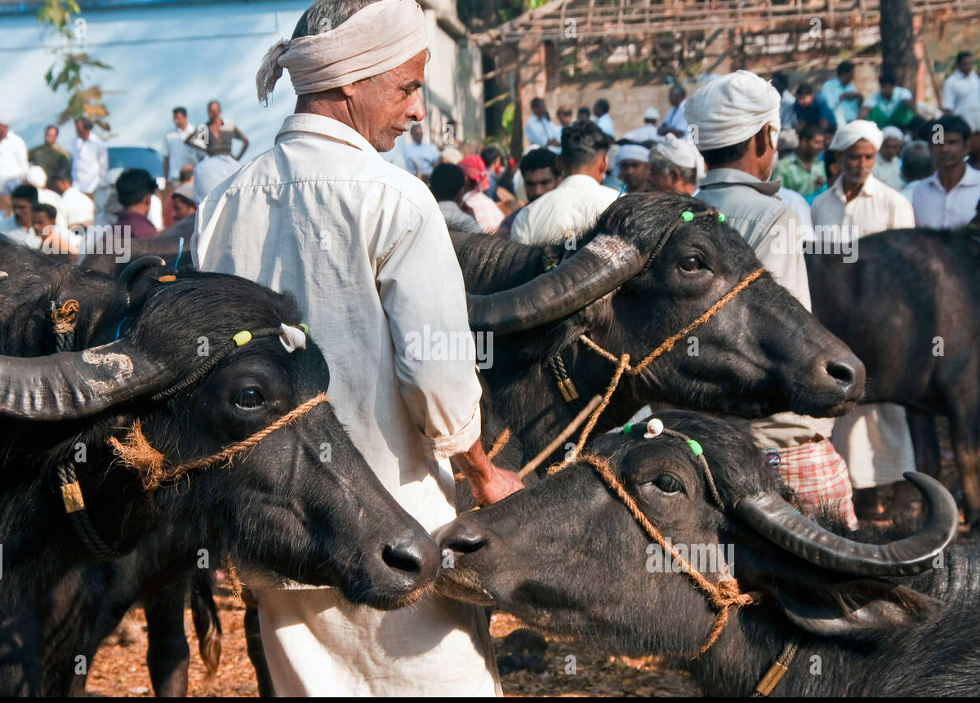
At present entrepreneurs/farmers interested in taking up dairy programme are facing difficulties in ‘sourcing disease free high yielding heifers or cows/buffaloes’ & therefore dependent on Cattle and Buffalo market for sourcing animals

Slide 3

DAHD launches BMF programme
Establishment of Breed Multiplication Farms through entrepreneurship model for making available high yielding cows/buffalo heifers to farmers at cost.
Provision of 50% capital subsidy (maximum Rs. 2 Cr.) has been made under the project.
For NER/Hilly States & 31 arid districts**, BMF with 50 animals (maximum 50 lakhs)
The balance 50% (40% + 10%) is to be managed by the beneficiary by obtaining loan from scheduled bank/any other financial institution in which beneficiaries’ contribution to be fixed as minimum 10% of the total project cost.
In case of self finance projects, beneficiary contribution shall not exceed 37.50% of the total project cost. Balance 12.5% to be managed by obtaining loan from scheduled bank/any other financial institution
NDDB is implementing agency (IA)

Slide 4

Objectives of the Scheme
To develop private entrepreneurs for undertaking cattle and buffalo breeding.
To make available disease free high yielding heifers/ pregnant heifers/cows preferably of indigenous breeds of cattle/buffalo.
To incentivize private individuals Entrepreneurs, FPOs, SHGs, JLGs, and Section 8 companies for establishment of breed multiplication farm.
Spreading awareness about scientific management practices including animal nutrition, disease prevention etc.
Multiplication of high yielding milch animals through scientific breeding including IVF technology and sexed semen.

Slide 5


Who are eligible to apply for the BMF Project?
Individual/Entrepreneur
(Family members can make a Joint Application (as Co-Applicants)
Organization
a. SHGs
b. FPOs
c. FCOs
d. JLGs and
e. Section 8 Companies.
Pvt. Ltd. Companies, Partnership Firms, NGOs, charitable trusts, gaushalas, etc. are NOT ELIGIBLE

Slide 6
Eligibility/Qualification Criteria
Land
200 animals - Min 5 Acre land in max 2 pieces within the same village.
50 animals - Min 1 Acre land in max 2 pieces within the same village.
Owned Land OR Leased Land (minimum for 10 years)
(Copy of ownership document (Khasara/Khatoni/Other land documents) or Registered long term lease deed of not less than 10 years. View Only or E-copies of land documents are not valid. Land documents must be in English/Hindi. Land documents if in Regional language, to be true translated in English duly Notarized. Photograph of land with dimensions.)
Net-worth (duly certified by Charted Accountant with UDIN No.)
The minimum required net-worth of the applicant should be Rs. 2 Crores OR One (1X) times of combined value of beneficiary contribution and loan amount (whichever is on the higher).
For BMF projects with 50 animals, net-worth required is One (1X) times of combined value of beneficiary contribution and loan amount.
(The Networth certificate should mention the details of Assets (Immovable and Movable and Liquid Assets like Bank Balance, FDs, Savings, Jewelry etc.) and Liabilities (Debt, Loans etc.) of the applicant. )

Slide 7

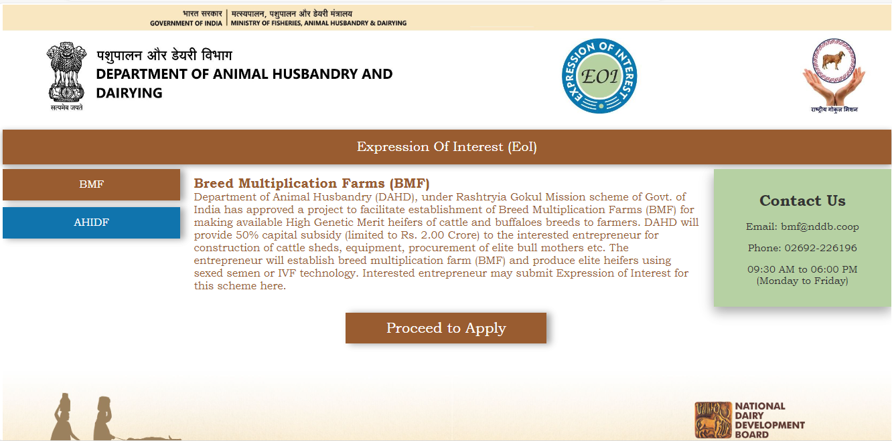
BMF Portal Link
https://eoi.nddb.coop
BMF Helpline No:
02692-226196
Monday to Friday
09:30 AM to 06:00 PM

Slide 8

Documents for Breed Multiplication Farm
Registration
Aadhar Number* and PAN* (mandatory for individuals)
GST No
Contact Person*/e-mail ID*/Mobile No*
Declaration as per Annexure I* duly notarized on Non-Judicial Stamp Paper by the Notary.
For Organization, duly notarized Certificate of Incorporation*/ Certificate of Registration by the Notary * .
Experience Certificate in Dairying or similar activities
Signed and sealed by local Government Veterinarian as per Annexure II* and training Certificate if training attended/details of the farm managed/details of the experienced manpower available. Training Certificates and size of farm managed
If no experience, documentary proof of contracting a veterinarian*. Signed by both applicant and concerned veterinarian with seal.
OR
If no experience in dairying, documentary proof of contracting a veterinarian*. Signed by both applicant and concerned veterinarian with seal.
Affidavit as per Annexure III* of EoI – on Non-Judicial Stamp paper duly notarized by the Notary
Proof of Address*/Photograph*/Caste Certificate (Optional)/Last Education Certificate (Optional)

Slide 9
Documents for Breed Multiplication Farm
Bank details:
Bank Name, Branch Address & Email
Detailed Project Report (DPR)
Introduction of Applicant
Purpose of establishment of BMF
Breed wise no. of Animals /Rationale for breed selection
Information of available infrastructure & animals
Availability of Water, Electricity, Feed & Fodder etc.
Project Goals/Objectives
Means of Finance
Capital & Revenue expenditure
Feed & Fodder/Medicine & Veterinary/Breeding/
Breeding Plan & Herd projections
Estimates for Milk production, manure etc.
Revenue/Income from milk, manure, heifer sales etc.

Slide 10
Components and Funding Pattern
Capital Subsidy can be used only for the following
Construction of Animal sheds, Calf pens, Calving pens, Feed & Fodder store etc.
Purchase of Equipment – Agri & Dairy equipment
Procurement of Elite Bull Mothers/Pregnant heifers/Cows/Buffaloes etc.

Slide 11

Application Screening Procedure
Screening of BMF Applications submitted with DPR
Eligibility based on Land requirements & Net-worth of the applicant
Supporting documents related to BMF application
Bank Forwarding Letters issued
Please note that receipt of Bank Forwarding letter does not mean the application is selected/approved for subsidy.
Applications with bank loan sanction letter
All documents (Land Documents, Net worth Certificate, DPR, Final Bank Sanction letter, ROI IRR sheet) of the applicant will be forwarded to DAHD for putting forth in upcoming National Steering Committee (NSC) meeting.
Grant Agreement b/w NDDB & Applicant (hard copy)
Approved by DAHD
Release of Grant Subsidy as per guidelines
Implementation & Monitoring of the project
DPR will be reviewed only if above mentioned criteria are fulfilled
Applicant is supposed to arrange for FINAL BANK SANCTION LETTER
Sanction Letter is mailed to the applicant
Physical Verification by NDDB
Proof of Loan disbursement and promoter’s contribution in BMF project account.
Opening of saving bank a/c (Vendor code creation)
Interest refund of GoI subsidy on 31st March of every year

Slide 12
Subsidy Release Pattern
1st
12.5%
Proof of disbursement by Bank and Promoter’s Contribution adding up to 12.5% of sanctioned loan amount and own contribution
2nd 12.5%
Submission of duly audited Fund Utilization Certificate (FUC) with supporting documents like bank statement, bills/invoices etc.
3rd 12.5%
Monitoring report of second physical verification confirming civil work for 200 animal shed is complete
4th 12.5%
Receipt of hard copy of duly signed Grant Agreement from Applicant
Proof of disbursement by Bank and Promoter’s Contribution adding up to 50% of sanctioned loan amount and own contribution
Monitoring report of first physical verification
Proof of disbursement by Bank and Promoter’s Contribution adding up to 25% of sanctioned loan amount and own contribution
Proof of disbursement by Bank and Promoter’s Contribution adding up to 37.5% of sanctioned loan amount and own contribution
Submission of duly audited Fund Utilization Certificate (FUC) with supporting documents like bank statement, bills/invoices etc.
Submission of duly audited Fund Utilization Certificate (FUC) with supporting documents like bank statement, bills/invoices etc.

Slide 13
Subsidy Release Pattern
5th
12.5%
6th 12.5%
Proof of disbursement by Bank and Promoter’s Contribution adding up to 75% of sanctioned loan amount and own contribution
7th 12.5%
Proof of disbursement by Bank and Promoter’s Contribution adding up to 82.5% of sanctioned loan amount and own contribution
8th 12.5%
Monitoring report of fourth physical verification confirming availability of targeted number of heifers for sale as per DPR.
Monitoring report of third physical verification confirming entire civil work is complete and 50% of the animals are inducted.
Proof of disbursement by Bank and Promoter’s Contribution adding up to 62.5% of sanctioned loan amount and own contribution
Submission of duly audited Fund Utilization Certificate (FUC) with supporting documents like bank statement, bills/invoices etc.
Submission of duly audited Fund Utilization Certificate (FUC) with supporting documents like bank statement, bills/invoices etc.
Submission of duly audited Fund Utilization Certificate (FUC) with supporting documents like bank statement, bills/invoices etc.
Monitoring report of fourth physical verification confirming remaining 50% of the animals are inducted and birth of 10% of calves.
Proof of disbursement by Bank and Promoter’s Contribution adding up to 100% of sanctioned loan amount and own contribution
Submission of duly audited Fund Utilization Certificate (FUC) with supporting documents like bank statement, bills/invoices etc.

Slide 14

Thank You

Slide 15
Indicative Cost of Model Project for establishment of Breed Multiplication Farm
Sr. No | Particulars | BMF for 200 Animals Total Cost (Rs in Lakh) | BMF for 50 Animals Total Cost (Rs in Lakh)
1 | Purchase of cows/buffaloes in first lactation/2nd lactation | 200 | 50
2 | Construction of Cow sheds 10 sq meter per cow sheds to house 200 cows and its followers | 100 | 25
3 | Construction of Isolation Shed | 2.5
4 | Administration Block | 20 | 5
5 | Feed & Fodder Store room | 40 | 10
6 | Tractor 75 HP, with agriculture implements | 10 | 2.5
7 | Dairy Equipment (BMC, stainless steel Milk cans, digital milko tester, deep freezer etc.) | 5 | 1.25
8 | Shed for Agri Implements | 22.5
9 | Chaff Cutter (electric) | 1 | 0.25
 | Total | 401 | 101

Slide 16
List of Arid Districts
Anantapur (Andhra Pradesh), 2 Banas Kantha, Jamnagar, Junagarh, Kutchh, Patan, Porbandar, Rajkot, Surendra Nagar (Gujarat), Bhiwani, Mahendragarh (Haryana) Leh, (J&K) Bagalkot, Bellari, Koppal (Karnataka), Bhatinda (Punjab) Ajmer, Barmer, Bikaner, Churu, Ganganagar, Hanumangarh, Jaisalmer, Jalore, Jhunjhunu, Jodhpur, Nagour, Pali, Sikar, Sirohi & Udaipur (Rajasthan).

